Slide 1
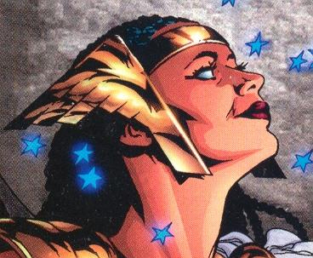
Promethea
Alan Moore, J.H. Williams III,
Mick Gray (DC Comics, 2000)

Slide 2
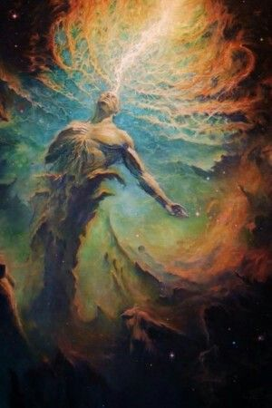
“The imagination is not a state: it is the human existence itself”
—William Blake

Slide 3
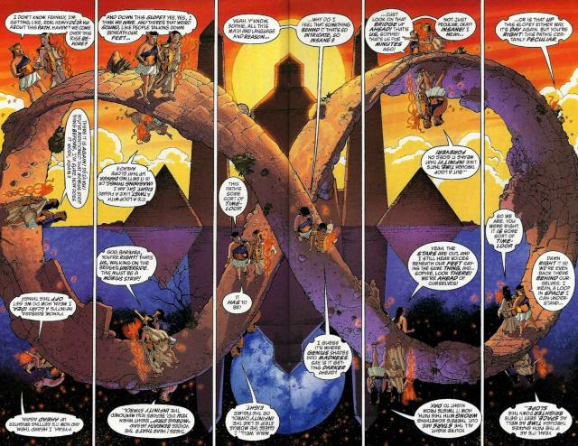
Class Contemplation
Is Promethea a visual lecture by Moore? If so, what is his worldview?
Or
is this bizarre contemporary hippie stuff? A mind on psychadelic drugs?

Slide 4
Alan Moore
Comic Book Legend
“the greatest writer in the history of the medium”
His work typically deals with the mystical & magical (the occult)
Fascinated with science and math

Slide 5
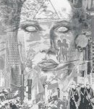
Landscape of the Mind
Strange New World View
Different levels/layers of reality
Not goofy new-age mumbo jumbo

Slide 6
Alan Moore
“the original idea behind Promethea was to come up with something that worked as a mainstream superhero character, maybe looked a bit like Wonder Woman or Dr. Strange in a weak light, and which would enable me to explore the magical concepts that I was interested in before a mainstream comics audience that may never have encountered these ideas before… Because in some sense, when I’m talking about magic, I’m only talking about the creative process. Magic to me is something from nothing, which includes rabbits out of hats, it includes the creation of the universe from a quantum vacuum, or it includes how a comic comes into being from me sitting in an armchair with a completely blank mind. It’s all of this. Any given creativity is magic.“

Slide 7
Premise
Setting contemporary New York—futuristic world
World of science heroes
Promethea a myth; a legend. She is a fictional character
Warrior princess of Hy Brasil
Promethea has come to life becoming people who believe in the power of the imagination

Slide 8
Moore’s “Idea Space”
Theory of “Idea Space”
mental space has no limit to it
physical space has limits; has boundaries
mental space really has no defined space
there is really is no such thing as distance
when our mind forms ideas or concepts, they are made of language, images, sounds
Promethea embodies the notion of “Idea Space”
Book is a landscape of the mind

Slide 9
Characters
Promethea: A feminine persona adopted by artists and writers over generations
Creature of the imagination
A living story
From the Immateria (the realm of the imagination)
She vascilates between realms; worlds
“I am all inspiration..all desire”
Sophie Bangs: Promethea’s new human host

Slide 10
Other Characters
Painted Doll—villainess (Joker like?)
Weeping Gorilla--Parody
Five Swell Guys-the “resident science-heroes” team
Barbara Shelley-the previous generation of Promethea-
Stacia: Sophie’s friend; closet homosexual; refers to Promethea as “Prositutia”, Prosthetica” and “Prolapsia”
Various formations; embodiments of Promethea—legacy of female knowledge passed down from generation to generation

Slide 11
Art & Technique of J.H. Williams III
Magical symbols
Complex and clean
Non-linear storytelling, yet cohesive
Use of borders and panels
Borders: function to divide space (to help reader make sense of things)

Slide 12
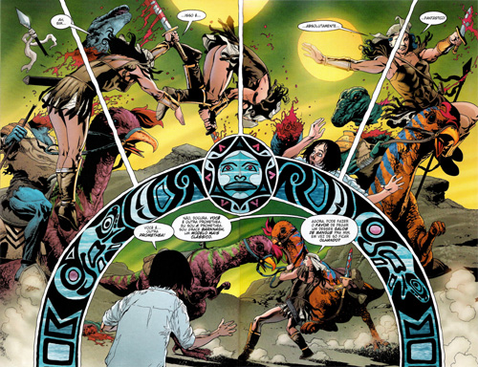
Borders: Immateria
absence (or less frequency) of borders;
Fluid
Unobstrusive
Unorthodox layouts of panels

Slide 13
Themes in Promethea
Power and experience of the imagination
Source of creativity
Power of myth
Power of storytelling
Art as a mode of escape
All individuals have the power of magic within (language, imagination, will)
Pay attention to your own individual experience—the one place you can
The slippery relationship between reality and fantasy
Critique of patriarchy, hierarchy
Reality is subjective-the only way to know the world is through our own consciousness

Slide 14
Setting 1: New York
Physical realm
sensible
The real or “unreal” city?
Futuristic
Science & technology-ways of thinking and doing things we used to let God do
Urban space: disorder—see panel positioning
Labyrinthine space (maze-like)
Site of displacement, disorientation
Darkness: the demonic spirit blends into the city backdrop

Slide 15
Setting 2: Immateria
Metaphysical realm
World of myth, fiction
The realm where dreams and stories come from
Anyone can channel Promethea from this realm
A place of liberation; freedom from oneself
Spiritual realm—we have access to a kind of info that is not given to us through our senses
Suspension of basic conventions of thoughts
A side of being human (other side-sensible)
An unframably complex world

Slide 16
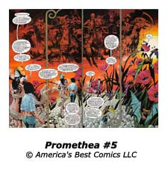
Setting 3: Apocalypse “dark age is coming”

Slide 17
Setting #3: Apocalypse
Refers to revelation
not the end of the world (not the Christian sense)
Promethea’s first crossing: brings about the end of the world
Apocalyptic: uncovering, revelation of something secretive
To Moore, it means a new way of looking at things
He equates the end of the world with when our ideas get radical –new and radical
A change in ways of thinking about the world’
A world where boundaries become eroded

Slide 18
Basic features of Apocalypticsm
1. Esoteric: covering; secret; only revealed to the elect; revelations are attributed to past distinguished individuals
2. Symbolism: combats with monsters; heavenly tablets; numbers; animal figures—the idea that there is deeper meaning than what lies beyond the surface
3. Dreams and visions: the standard mode of communication; from an external source (versus Freudian and Jungian notion—dreams come from an eternal source)
4. Otherwordly travel
5. God in control of history (free will within a larger determined framework)
6. Angels and Demons: Angels are mediators and guides; demons try to thwart divine contact

Slide 19
Basic features of Apocalyptism
7. the end of time is near-violence will increase—the world is getting worse; final grand triumph of good over evil-you can tell the end is near by the degree of horror and suffering
8. Messiah (Hebrew)—the anointed one will come-in charge of forces of good
9. Punishment and reward: the bad will be punished; good are rewarded
10. Dualism: up/down; saved/damned; good/evil; white/black; light/darkness

Slide 20
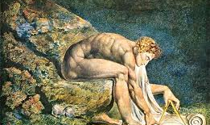
William Blake: Newton

Slide 21
Realm of the Sensible:
Sensible world—ordinary reality of experience
It is hard work to maintain a normal sense of reality
Every framework has its limits
Living only in this way brings anxiety
According to Promethea, if you function within these boundaries, you are impoverishing yourself
There is a chaos (non orderly, non-reasonable) that you should embrace

Slide 22
Prologue: Origin Story
Death of the father—death of magic
God versus evil established
Dualism established
Inner and outer
Convention versus working outside convention & rules
Villains—trying to kill the source (of the imagination)
Starts with an ancient culture (mesopotamia) that has nothing to do with Apocalypticism –this is a Hebrew notion

Slide 23
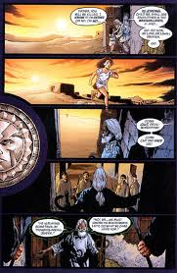
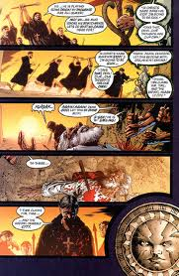
Origins Story: not a religious story….

Slide 24
Symbols: Used in Narrative Patterns
Snake: serpent as the symbol of evil, submission to temptation, theme of non-knowing—in the Bible,
Sun: light source
Stairs (Jacob’s Ladder): mystical meaning: ascent and descent (of the soul),
Her staff (caduceus): represents her mythical past; the axis mundi (connection between heaven and earth); god Hermes
The spiraling, cosmic serpents; crossing; intertwining of imagination and physical

Slide 25

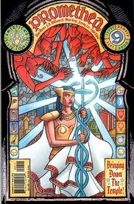
Caduceus

Slide 26
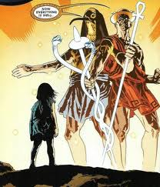
Axis Mundi

Slide 27
Promethea
Promethea, as a narrative, and Promethea as a superhero, reminds us that there is something deeper in the world, something that connects us that we can not quite articulate, but that we have somehow gotten ourselves away from.
She shows us what the world would look like if we opened up or expanded our perceptions of it? What would our experiences feel like then?

Slide 28
Promethea: Heroic Characteristics
Conventional:
Flying
Outfit/costume
Totem
Strength
Knowledge
Unconventional:
Love
Compassion
Curiosity
Her Weapon: Imagination
Her Training: creativity

Slide 29
Promethea’s Quest
Her journey is a personal journey of spirituality and magic
What is the purpose or goal of her journey?
Overcoming an evil?
Overcoming reality?
Returning to reality? to things as they really are?
Find Barbara’s soul?

Slide 30
Promethea’s Quest cont’d…
to reconcile duality between Sophie Bangs and Promethea
Transformation of mortal into immortal being; corporeal to spirit; human to divine
Heroic journey has to do with synthesizing these two aspects of her identity—her transformation is into a higher state of consciousness

Slide 31
Four Weapons (necessary to be a fully integrated human)
the sword of ‘reason’
the cup of ‘compassion’
the pentangle of the ‘spirit’
the disc or wand of physical existence, called the worldly ‘carnival’

Slide 32
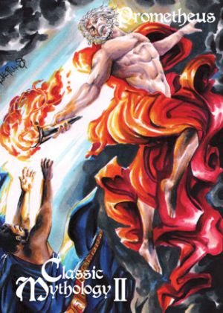
Promethea’s Power & Prometheus the Rebel
Imagination
Four elements: earth, water, wind, fire
Channels her powers

Slide 33
Mythical Traditions
The figures, Thoth-Hermes, manifest in her appearance.
Greek God, Hermes
Egyptian Deity, Thoth
Prometheus
Significantly, during Sophie's first transformation into Promethea, she declares “I bring you fire”
She delivers art, creativity, knowledge to mankind

Slide 34
Function of Magic
Closely associated with science
Superheroes of Manhattan: Science-heroes, not “magicians”
Moore working within the traditional sense of magic (despite the presence of science-heroes)
Interested in Kabbalah, tarot
The very act of writing; the act of the imagination—of bringing ideas into being is a magical act

Slide 35
3 Kinds of Magic
1. White magic
Benevolent
Productive of love, health, fertility
Success in one’s undertakings
Protection from misfortune and good luck, generally
2. Black Magic
Malevolent
Reverse of white magic
Includes necromancy (raising of spirits)
Fascination
--related to envious praise or ill-wishing (evil-eye)
2. Prognostic Magic
Prophecy
Divination

Slide 36
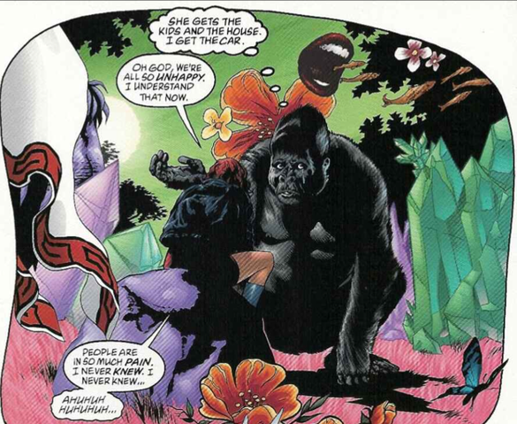
Humour and Satire
Mayor has multiple personalities
Weeping Gorilla—comic villain
He depresses everyone around him
An ongoing joke

Slide 37
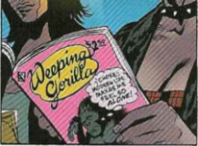
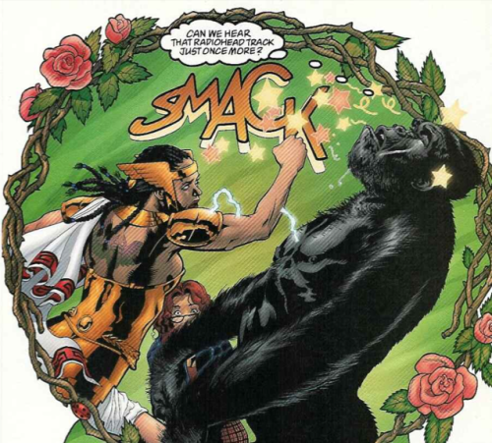
Weeping Gorilla

Slide 38
Promethea as Flesh, embodiment
Visible Word Masculine
Crossing -----x-------- ------x----- ---------x---------
Invisible Image Feminine
Categories are seemingly opposed
Promethea embodies the unity of them—her physical form is the crossing made flesh
The female body is an integration of these
Comics books also do this-integrates the visible & invisible, and the word and image

Slide 39
Take home point
We don’t get to live in the world of the imagination, it eventually changes the physical world
Art gives us access to that “other” realm
Universal reciprocity—bring the good stuff across
Experience of love; experience of the imagination is outside time—cannot be damaged
We’ve gotta get connected
Break down perceptual boundaries to experience the world anew

Slide 40
Categories of Word-Image Combinations:
Word specific: pictures illustrate to don’t add to make an idea complete
Picture specific: picture dominates—words do little more than add sound
Duo-specific: both pictures and words send the same message
Additive: words amplify or elaborate an image or vice versa
Parallel: words and pictures follow very different courses without intersecting—not related
Montage: words are treated as integral parts of the picture
Interdependent: most common type of combo. Words and pictures go hand-in-hand to convey an idea that neither could convey alone

